Slide 1
Android Networking and Threading

Slide 2
Networking and Threading
Connecting to internet is one of the most important tasks and services for mobile devices.
Network operations can involve unpredictable delays.
To prevent this from causing a poor user experience, always perform network operations on a separate thread from the UI.

Slide 3
Threading
A Thread is a concurrent unit of execution.
Each thread has its own call stack and stores their arguments and local variables.
Each virtual machine instance has at least one main Thread running when it is started.
Then, the main Thread may create other several threads for specific purposes, such as I/O process.

Slide 4
Threading
Android modifies the user interface and handles input events from the main thread (also called UI thread).
Usually all code of an Android application runs in this thread.
If you perform a long lasting operation, e.g. loading a file or accessing data from the Internet, the user interface of your application blocks until the corresponding code has finished.

Slide 5
Threading
To provide a good user experience all potentially slow running operations in an Android application should run asynchronously, i.e. on another thread.
Android enforced that with an Application not responding (ANR) dialog if an activity does not react within 5 seconds to user input. From this dialog the user can choose to stop the application.

Slide 6
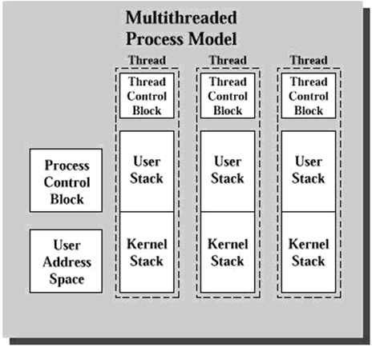
Threading
* User Address Space is the memory allocated for storing variables.

Slide 7
Threading
Advantages of Multi-Threading
Threads share the process' resources but are able to execute independently.
Applications responsibilities can be separated.
main thread runs UI, and
slow tasks are sent to background threads.
Threading provides an useful abstraction of concurrent execution.
Under multiple CPUs system, it can achieve true multi-process, thus the operations are faster.

Slide 8
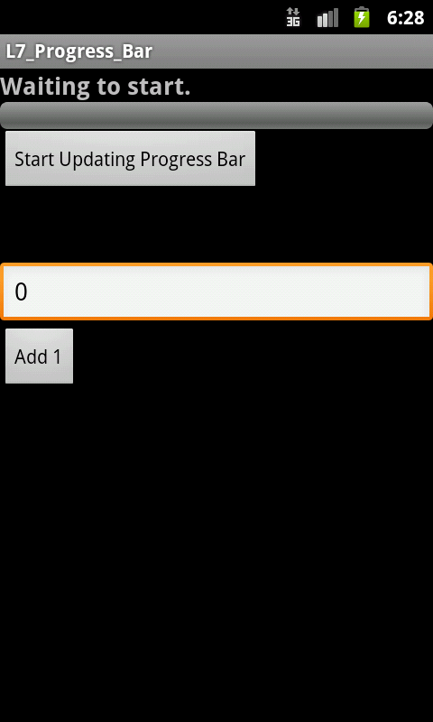
Example of Multi-Threading
The program intends to display a horizontal progress bar widget showing the progress of a slow background operation (20s).
While the Progress is being updated, user can also click the “Add 1” button to increase the number in the TextView object by 1.

Slide 9
XML Layout of Example
<?xml version="1.0" encoding="utf-8"?>
<LinearLayout xmlns:android="http://schemas.android.com/apk/res/android"
android:layout_width="match_parent"
android:layout_height="match_parent"
android:orientation="vertical" >
<TextView android:id="@+id/TextView01"
android:layout_width="match_parent"
android:layout_height="wrap_content"
android:text="Working ...."
android:textSize="18sp"
android:textStyle="bold" />
<ProgressBar android:id="@+id/progress"
android:layout_width="match_parent"
android:layout_height="wrap_content"
style="?android:attr/progressBarStyleHorizontal" />
<Button
android:id="@+id/bUpdate"
android:layout_width="wrap_content"
android:layout_height="wrap_content"
android:text="Start Updating Progress Bar"
android:onClick="update"/>

Slide 10
XML Layout of Example
<LinearLayout
android:layout_width="match_parent"
android:layout_height="50dp" >
</LinearLayout>
<EditText
android:id="@+id/tvNum"
android:layout_width="match_parent"
android:layout_height="wrap_content"
android:ems="10"
android:text="0" >
<requestFocus />
</EditText>
<Button
android:id="@+id/bAdd1"
android:layout_width="wrap_content"
android:layout_height="wrap_content"
android:text="Add 1"
android:onClick="add1"/>
</LinearLayout>

Slide 11
Activity Code
public class Progress_BarActivity extends ActionBarActivity {
ProgressBar bar1;
TextView msgWorking;
TextView tvNum;
Button bUpdate;
Button bAdd1;
final int MAX_SEC = 20; // (seconds) lifetime for background thread
/** Called when the activity is first created. */
@Override
public void onCreate(Bundle savedInstanceState) {
super.onCreate(savedInstanceState);
setContentView(R.layout.main);
bar1= (ProgressBar) findViewById(R.id.progress);
bar1.setMax(MAX_SEC);
bar1.setProgress(0);
tvNum= (TextView)findViewById(R.id.tvNum);
msgWorking= (TextView)findViewById(R.id.TextView01);
bUpdate = (Button) findViewById(R.id.bUpdate);
bAdd1 = (Button) findViewById(R.id.bAdd1);
}

Slide 12
Activity Code
public void update(View v) {
Random rnd= new Random();
int time_elapsed = 0; // in msec
bar1.setProgress(0);
msgWorking.setText("Waiting to start.");
while (time_elapsed < MAX_SEC*1000) {
// Sleep randomly from 0.5 to 1 second
int t = 500 + (int) rnd.nextInt(500) ;
try {
Thread.sleep(t); // sleep t msec
}
catch (InterruptedException e) {
e.printStackTrace();
}
time_elapsed += t;
bar1.setProgress(100*time_elapsed/MAX_SEC*1000);
msgWorking.setText("Working..."+
bar1.getProgress() );
}
msgWorking.setText("Done!");
}
public void add1(View v) {
I nt n = Integer.parseInt(tvNum.getText().toString());
tvNum.setText(n+1+"");
}
}
The UI Thread cannot do anything until “update” finishes

Slide 13
HTTP
HTTP stands for hyper text transport protocol.
HTTP is the standard transport protocol for web browser <----> web server communication.
One of the key features of HTTP is that communication is stateless between requests.
Android contains the Apache HttpURLConnection library for performing network operations in Android.
Obtain a new HttpURLConnection by calling URL.openConnection() and casting the result to HttpURLConnection.

Slide 14
Internet Permission
To access the internet your application requires the "android.permission.INTERNET" permission in the file AndroidManifests.xml.
<uses-permission android:name="android.permission.INTERNET" />

Slide 15
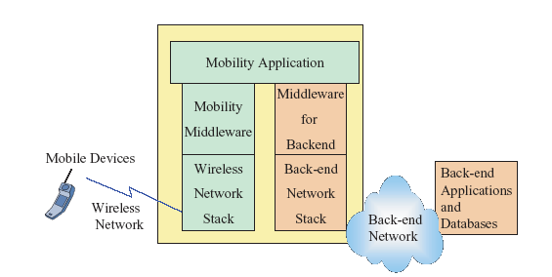
Passing Parameters to Server
Typically, an HTTP request to a server is accompanied by information needed by the server to process the request.

Slide 16
Passing Parameters to Server
e.g. Login in case.
A server must authenticate a client using the client’s user ID and password.
The client sends the user ID and password along with the HTTP request.
Two techniques are used to send data to the server: GET or POST request methods.
The GET request method requires that data be concatenated to the URL of the server.
The POST request method requires that each pair value be written to the output stream (NOT covered in this chapter).

Slide 17
Code example
URL url = new URL(urlString); HttpURLConnection conn = (HttpURLConnection) url.openConnection(); conn.setReadTimeout(10000 /* milliseconds */); conn.setConnectTimeout(15000 /* milliseconds */); conn.setRequestMethod("GET"); conn.setDoInput(true);

Slide 18
JSON
JavaScript Object Notation (JSON) is a lightweight text-based open standard designed for human-readable data interchange.
It is derived from the JavaScript programming language and is language-independent, with parsers available for most programming languages.
Similar to XML and has quickly become one of the most popular formats for data exchange on the internet.

Slide 19
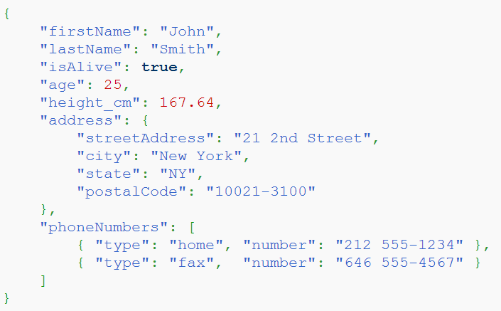
JSON Example
Why JSON?
JSON is faster and easier than XML.

Slide 20
JSON
JSON Syntax Rules
Data is in name/value pairs
Data is separated by commas
Curly braces hold objects
Square brackets hold arrays
JSON Name/Value Pairs
JSON data is written as name/value pairs:
"firstName" : "John"
JSON value can be: a number, a string, a Boolean, an array, an object or null
Can you give an example for each of the JSON value type from the above JSON personal record?

Slide 21
JSON
JSON Objects
JSON objects are written inside curly brackets,
Objects can contain multiple name/values pairs:
{ "firstName":"John" , "lastName":"Doe" }
JSON Arrays
JSON arrays are written inside square brackets.
An array can contain multiple objects:
{ "employees": [ { "firstName":"John" , "lastName":"Doe" }, { "firstName":"Anna" , "lastName":"Smith" }, { "firstName":"Peter" , "lastName":"Jones" } ] }

Slide 22
Parsing JSON Data
A typical Android network application is to retrieve a JSON data from internet.
Your task is to parse it and obtain the values it stores.
Android provides a set of API to parse a JSON data.
Your very first step is to create a JSON object for the data received:
JSONObject jObj = new JSONObject(data);
Then you can use this object with the getXXX methods to extract the values from the JSON data.

Slide 23
JSONObject get Methods
Object | get(String name) Returns the value mapped by name.
boolean | getBoolean(String name) Returns the value mapped by name if it exists and is a boolean or can be coerced to a boolean.
double | getDouble(String name) Returns the value mapped by name if it exists and is a double or can be coerced to a double.
int | getInt(String name) Returns the value mapped by name if it exists and is an int or can be coerced to an int.
JSONArray | getJSONArray(String name) Returns the value mapped by name if it exists and is a JSONArray.
JSONObject | getJSONObject(String name) Returns the value mapped by name if it exists and is a JSONObject.
long | getLong(String name) Returns the value mapped by name if it exists and is a long or can be coerced to a long.
String | getString(String name) Returns the value mapped by name if it exists, coercing it if necessary.

Slide 24
Parsing JSONObject
Suppose data stores the string shown and a JSONObject is created
JSONObject jObj = new JSONObject(data);
To get the first name you use
String fName = jObj.getString("firstName");
To get the age you use
int age = jObj.getInt("age");
A slightly more complicated example: to get the city you need two steps:
JSONObject addrObj = jObj.getJSONObject("address");
String city = addrObj.getString("city");

Slide 25
Parsing JSONArray
JSONArray provides similar getXXX methods as JSONObject with index, instead of name, as the parameter. Also it provides the method length() which returns the numbers of element it holds.
The index begins from 0.
For example, to get the fax number (index 1) you need three steps:
JSONArray phoneArray = jObj.getJSONArray("phoneNumbers");
JSONObject faxObj = phoneArray.getJSONObject(1);
String fax = faxObj.getString("number");
The above lines can be combined into one statement:
String fax = jObj.getJSONArray("phoneNumbers"). getJSONObject(1).getString("number");

